Slide 1

Customer Shopping Behavior Analysis
Uncovering insights from 3,900 purchases to guide strategic business decisions

Slide 2

Dataset Overview
3,900
18
50
Total Purchases
Data Points
Locations
Transactions analyzed
Features per customer
Geographic coverage
4
Categories
Product types tracked

Slide 3
Data Preparation Journey
01
02
03
Data Loading & Exploration
Missing Data Handling
Feature Engineering
Imported dataset, checked structure with pandas
Imputed 37 missing review ratings using category medians
Created age groups and purchase frequency metrics
04
05
Data Consistency
Database Integration
Standardized columns, removed redundant promo code field
Connected to PostgreSQL for advanced SQL analysis

Slide 4
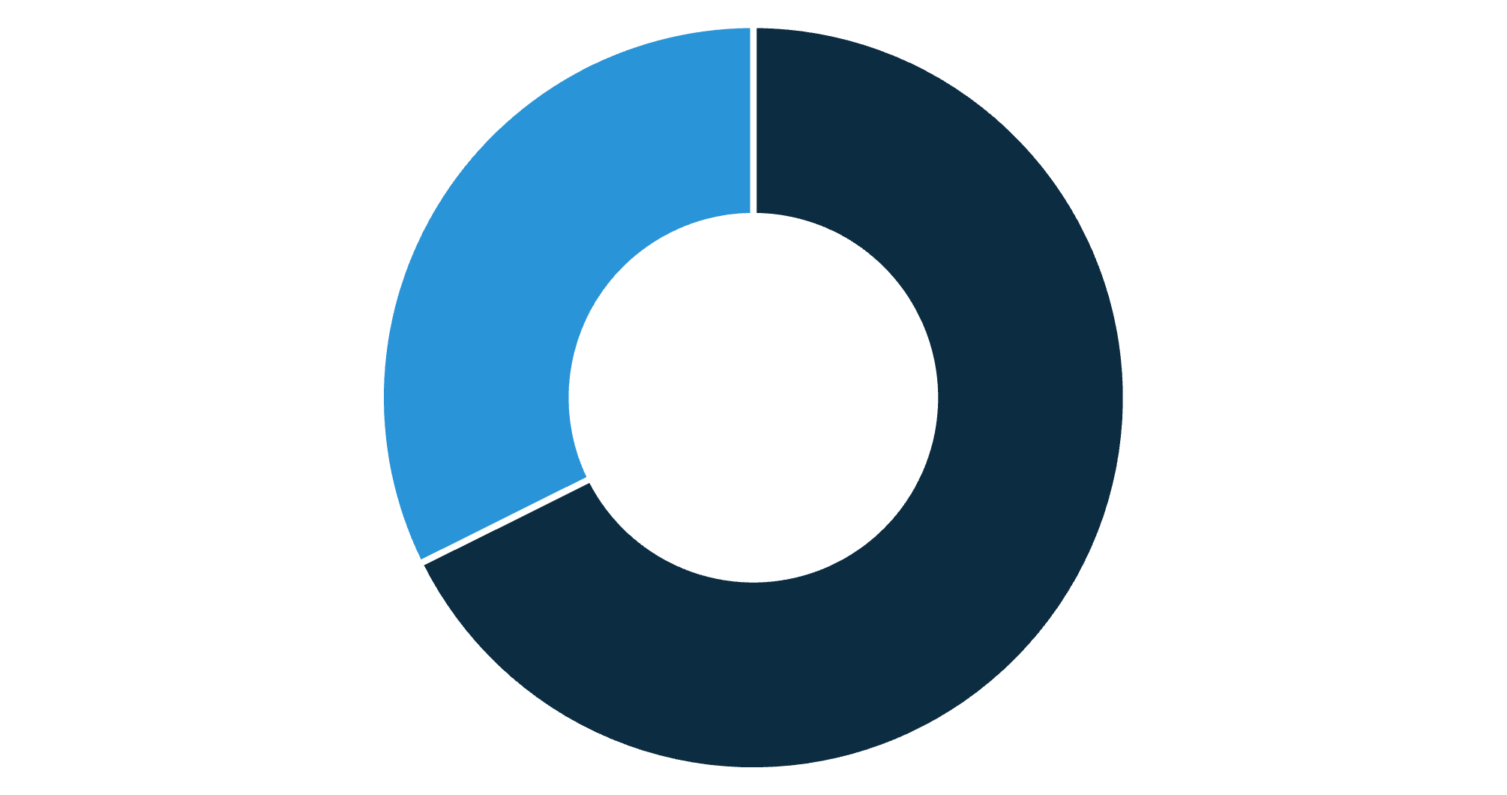
Revenue Insights by Gender
Male Customers Drive Revenue
Male shoppers generate 68% of total revenue despite representing 68% of customer base
Female customers show consistent spending patterns with strong engagement
Male
Female

Slide 5






Product Performance Leaders
Gloves
Sandals
Boots
3.86 rating
3.84 rating
3.82 rating
Top-rated product
Customer favorite
Strong performer
Hat
Skirt
3.80 rating
3.78 rating
Consistent quality
Popular choice

Slide 6



Customer Segmentation Breakdown
Returning
701 customers
18% showing repeat behavior
Loyal Customers
3,116 customers
80% of customer base
New Customers
83 customers
2% first-time buyers

Slide 7
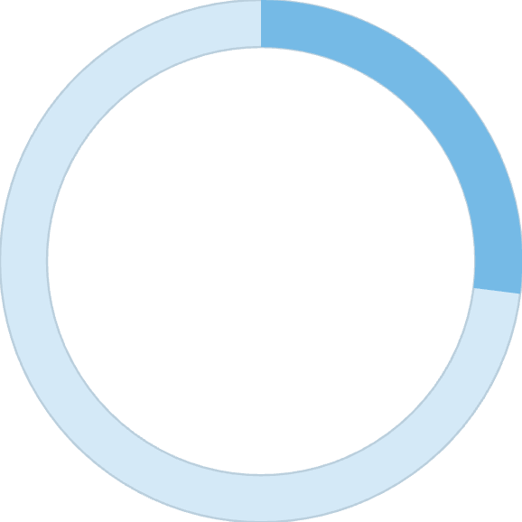
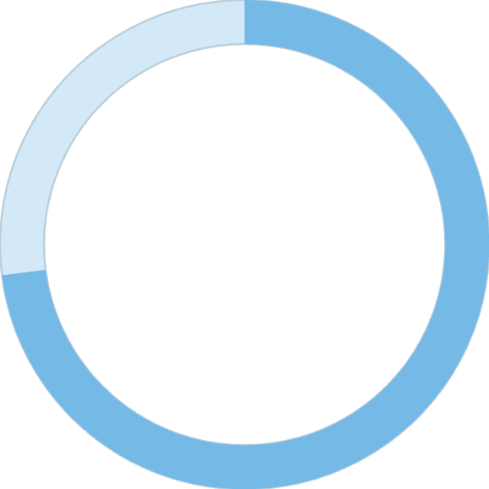
Subscription Status Analysis
Key Finding
Subscribers spend $59.49 on average
Non-subscribers spend $59.87 on average
27%
Minimal spending difference suggests opportunity to enhance subscription value proposition
Subscribers
1,053 customers
73%
Non-Subscribers
2,847 customers

Slide 8
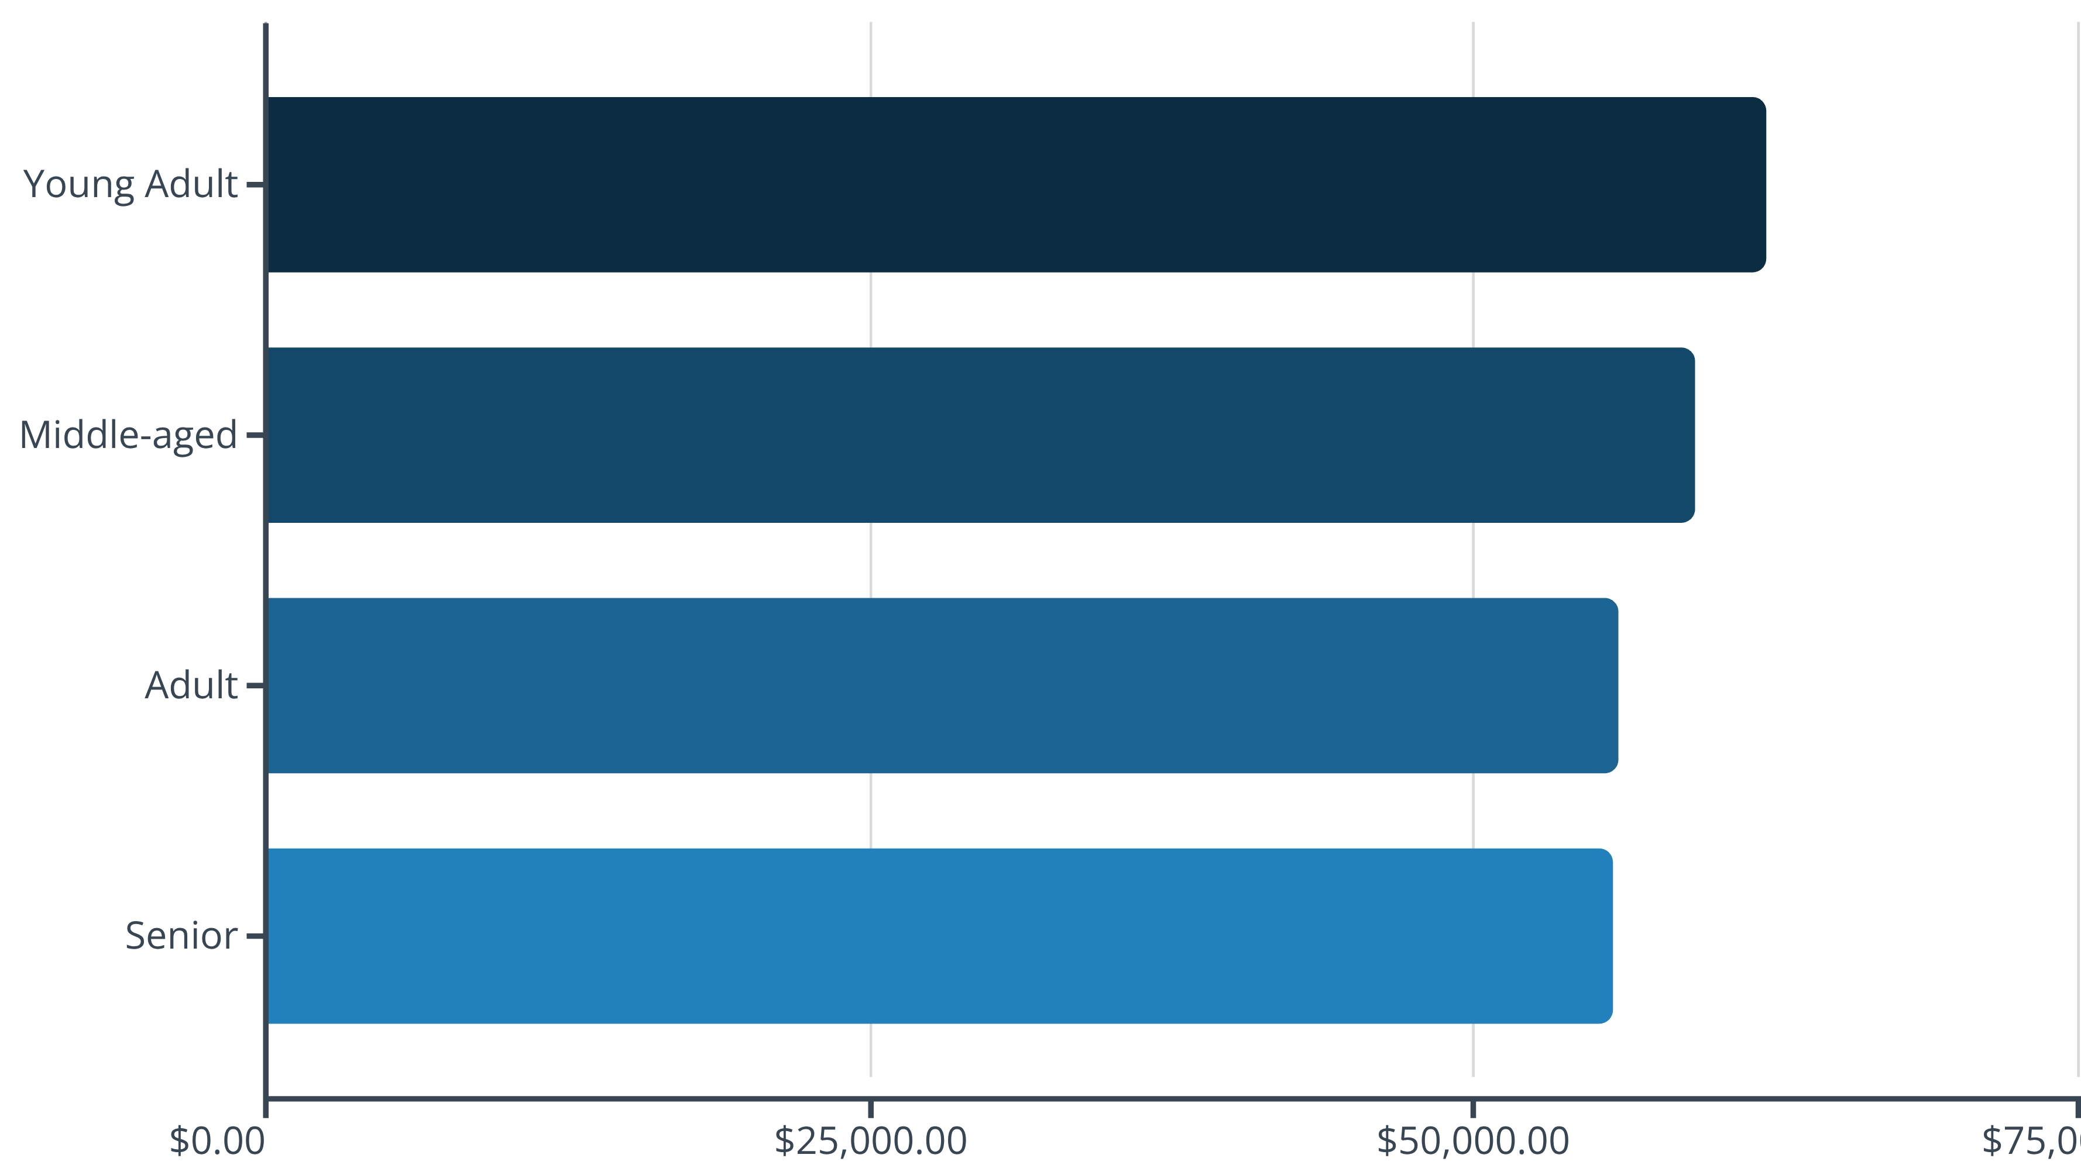
Revenue Distribution by Age
Young adults lead revenue generation, followed closely by middle-aged customers

Slide 9
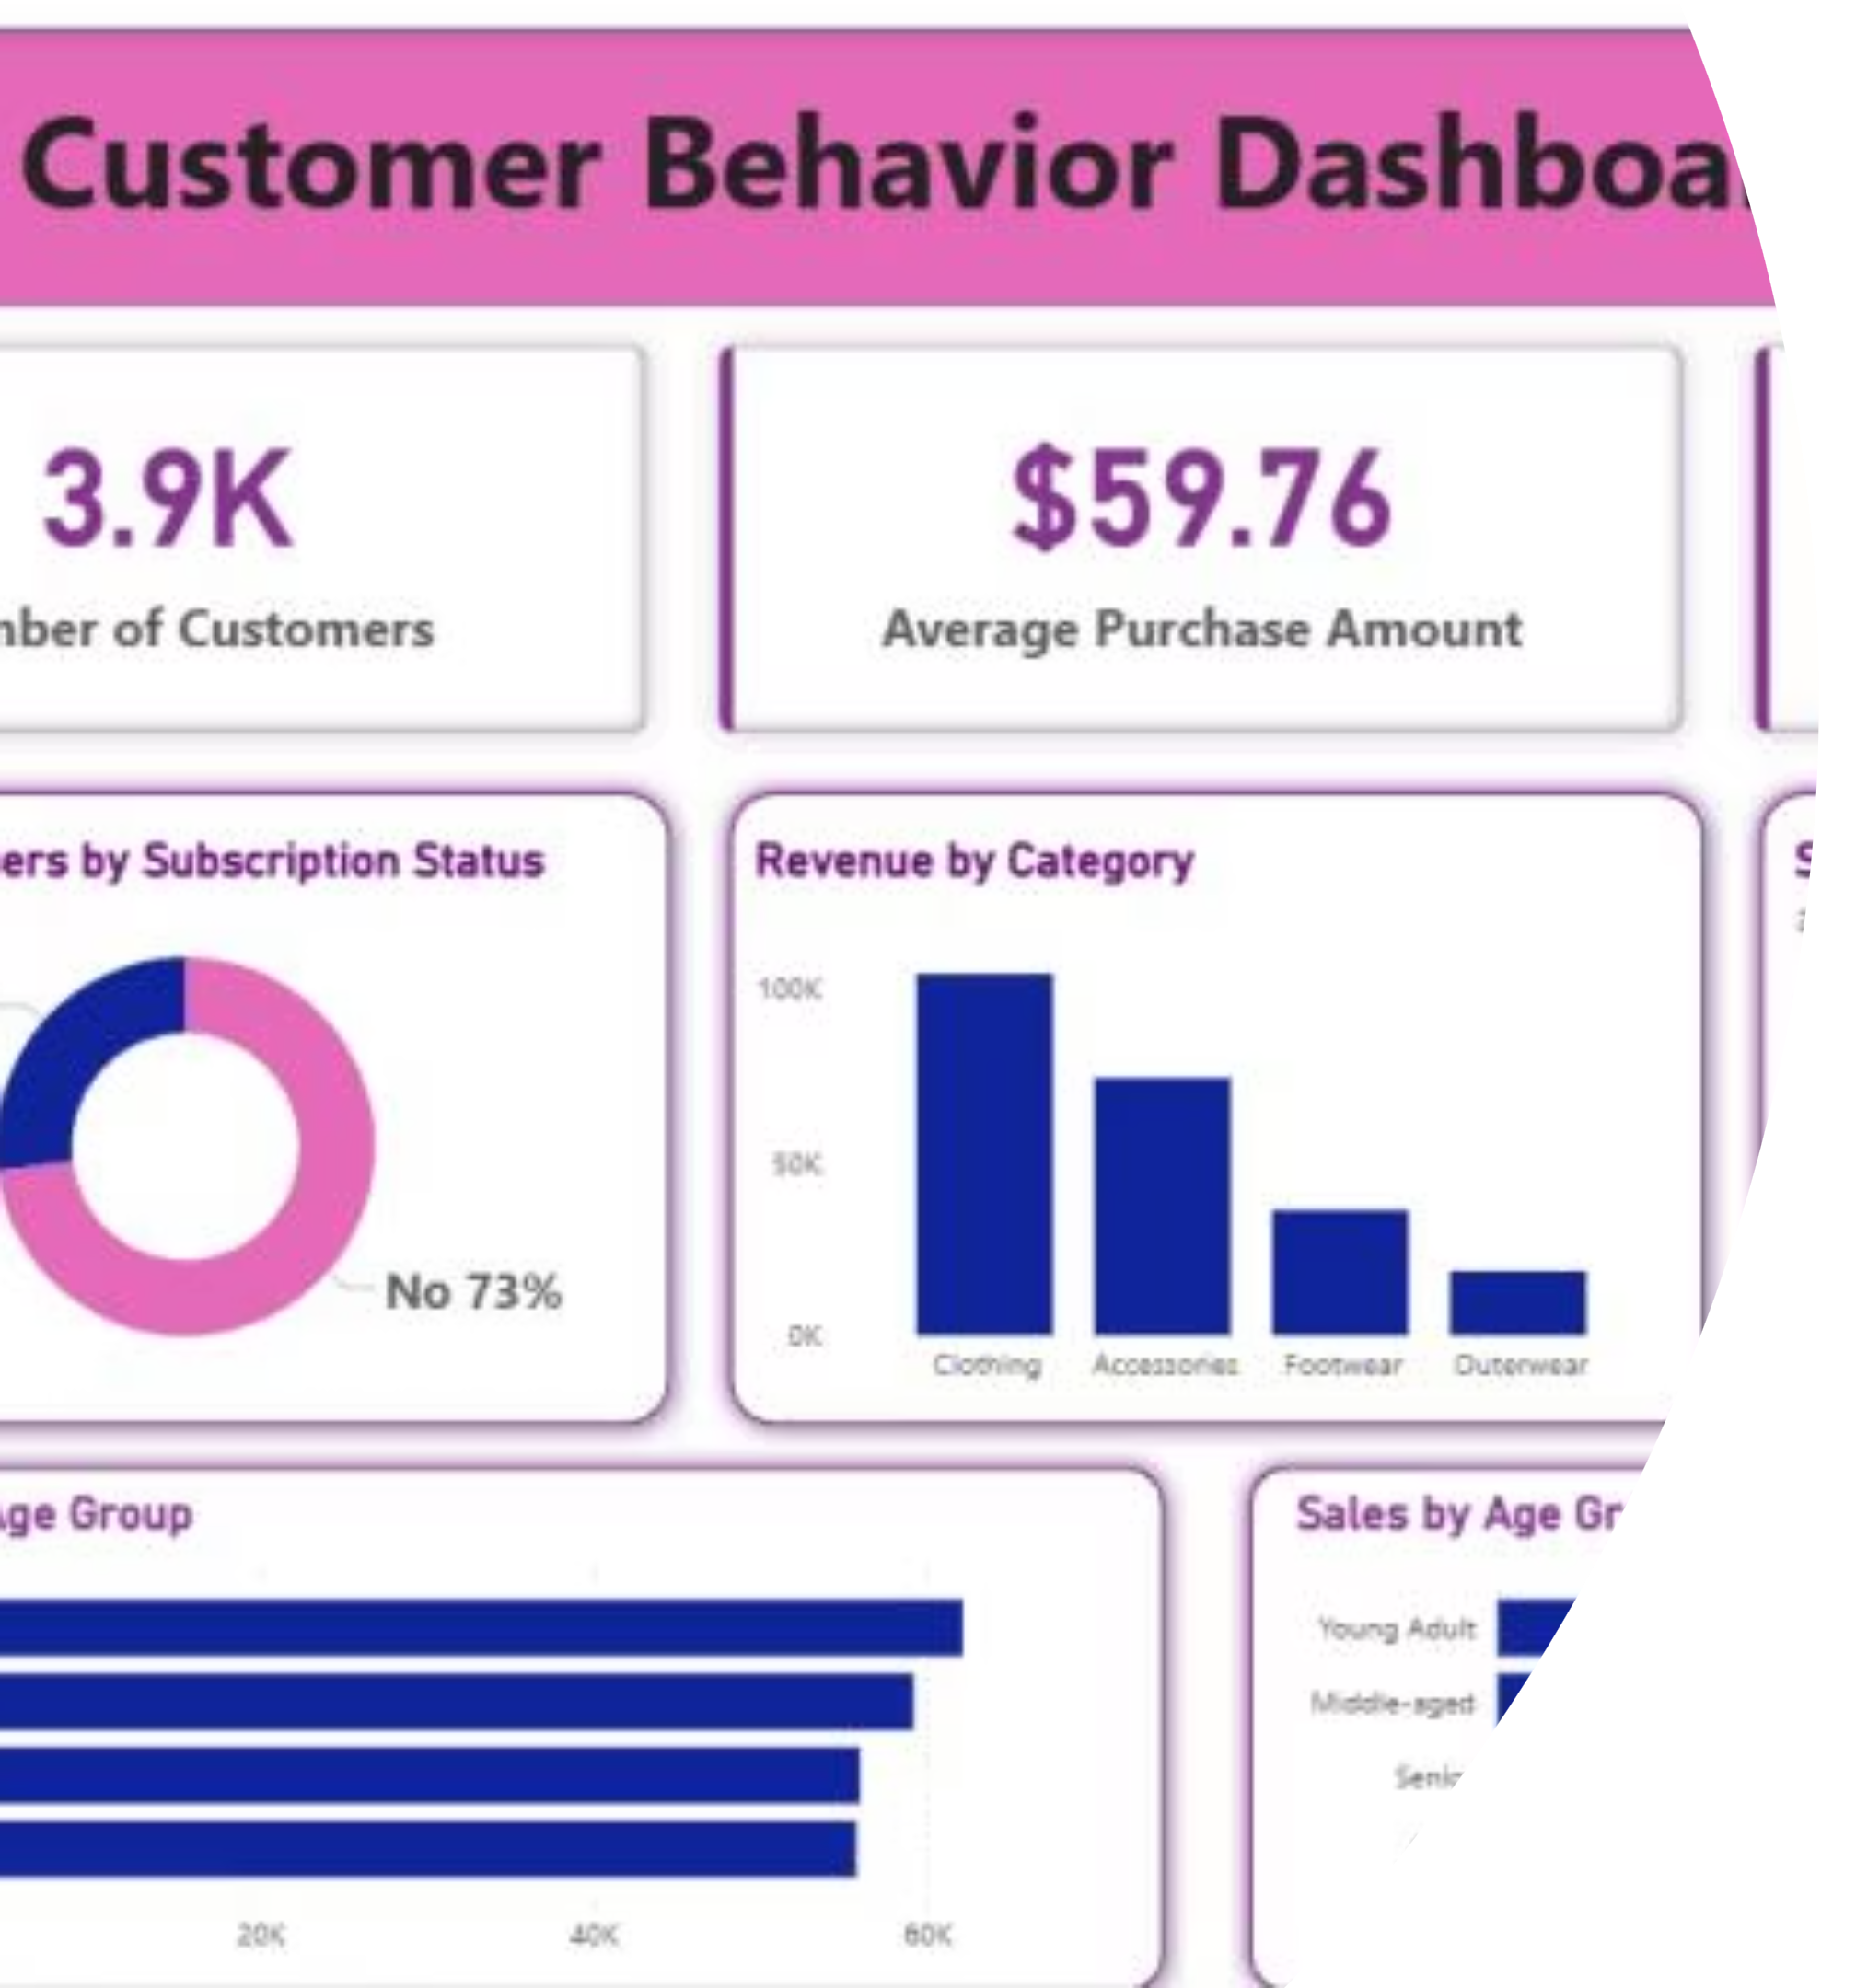
Power BI Dashboard Highlights
3.9K Customers
Total customer base analyzed
$59.76 Average
Purchase amount per transaction
3.75 Rating
Average customer satisfaction

Slide 10
Strategic Recommendations
Boost Subscriptions
Promote exclusive benefits to increase 27% subscription rate
Loyalty Programs
Reward repeat buyers to grow loyal customer segment
Review Discount Policy
Balance sales boosts with margin control for profitability
Targeted Marketing
Focus on high-revenue age groups and express-shipping users
Product Positioning
Highlight top-rated products in marketing campaigns

